Slide 1



Camelrace
Matthew Demyttenaere
Robin Geldolf
Ewout Merckx
Notes:
Robin

Slide 2
Index
Problem
Used technologies
Realizations
Demo
Not realized
Future / reflection
Conclusion
Notes:
Robin

Slide 3
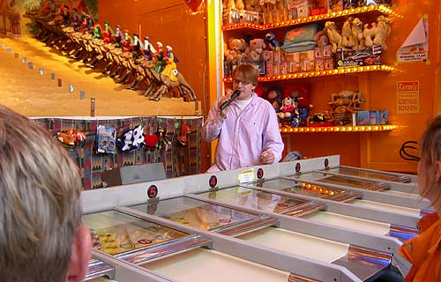
Problem
Notes:
Robin

Slide 4

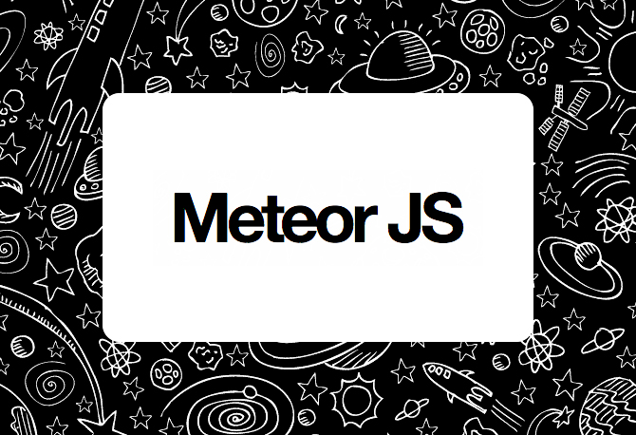

Used technologies
+
=
Spark.js (Hot Code pushes)
+
Meteor’s Smart Packages &
Meteorite
+
Notes:
Hoe templating systeem werkt Handlebars ? Ewout
Hoe database systeem werkt (ddp) ? Matt
Hoe Snap.svg werkt ? Svg zelf uitleggen ? Ewout
Hoe package manager werkt Meteorite? Robin
Hoe werkt Node.js ? Matt
Hoe werkt securtity in meteor.js (isclient, is server) Bestand systeem structuur ? Robin
Hoe sessions werken in meteor ? Matt
Hoe het ball throwing systeem werkt ? Ewout
Hoe werkt meteor router ? Matt

Slide 5
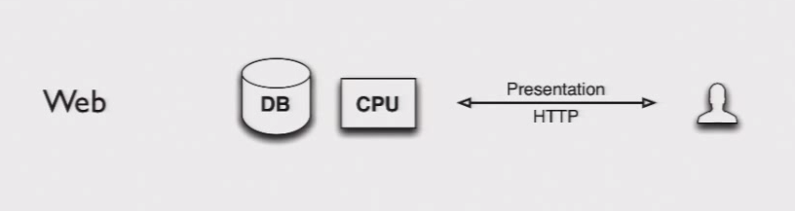
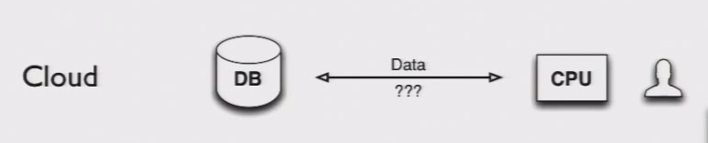
Used technologies
PHP / Rails
JSON / AJAX
Camelrace
5
Notes:
Hoe templating systeem werkt Handlebars ? Ewout
Hoe database systeem werkt (ddp) ? Matt
Hoe Snap.svg werkt ? Svg zelf uitleggen ? Ewout
Hoe package manager werkt Meteorite? Robin
Hoe werkt Node.js ? Matt
Hoe werkt securtity in meteor.js (isclient, is server) Bestand systeem structuur ? Robin
Hoe sessions werken in meteor ? Matt
Hoe het ball throwing systeem werkt ? Ewout
Hoe werkt meteor router ? Matt
5

Slide 6
Used technologies
Page is requesting data without a page refresh
DDP
// On the server
Meteor.publish('Games', function () {
return Games.find();
});
JSON & Distributed Data Protocol (DDP)
// On the client
Games = new Meteor.Collection('Games');
Meteor.subcribe('Games');
// On the client data is now in cache. Fast local DB
// DDP now intelligently polls your database to pick up changes and push them down to the client.
Camelrace
6
Notes:
Hoe templating systeem werkt Handlebars ? Ewout
Hoe database systeem werkt (ddp) ? Matt
Hoe Snap.svg werkt ? Svg zelf uitleggen ? Ewout
Hoe package manager werkt Meteorite? Robin
Hoe werkt Node.js ? Matt
Hoe werkt securtity in meteor.js (isclient, is server) Bestand systeem structuur ? Robin
Hoe sessions werken in meteor ? Matt
Hoe het ball throwing systeem werkt ? Ewout
Hoe werkt meteor router ? Matt
6

Slide 7
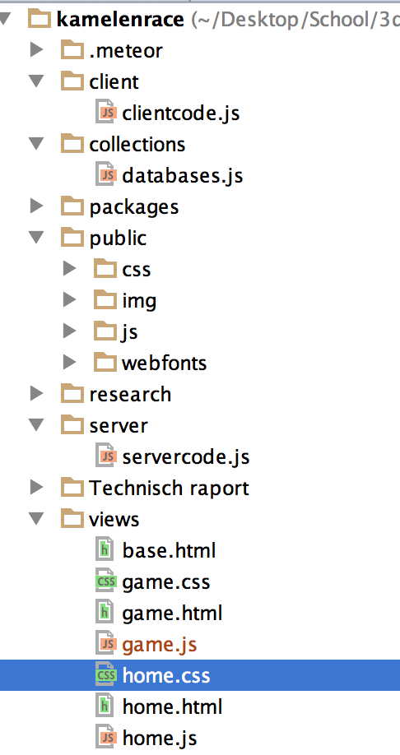
Used technologies
Smart package: meteor-router
// In the common code (clientcode.js)
Meteor.Router.add({
'/': 'home',
'/game/:_id': { to: 'game', and: function (id) {
Session.set('GameId', id);
}},
'*': 'not_found'
});
Camelrace
7
Notes:
Hoe templating systeem werkt Handlebars ? Ewout
Hoe database systeem werkt (ddp) ? Matt
Hoe Snap.svg werkt ? Svg zelf uitleggen ? Ewout
Hoe package manager werkt Meteorite? Robin
Hoe werkt Node.js ? Matt
Hoe werkt securtity in meteor.js (isclient, is server) Bestand systeem structuur ? Robin
Hoe sessions werken in meteor ? Matt
Hoe het ball throwing systeem werkt ? Ewout
Hoe werkt meteor router ? Matt
7

Slide 8
Used technologies
Meteor – Security
Server
// On the server
Games.allow({
insert:function (userId, doc) {
return (userId && doc.playerId === userId);
},
update: function (userId,doc) {
return doc.playerId === userId;
}
remove: function (userId, doc) {
return false ;
}
});

Slide 9

Used technologies
<template name="home">
<svg id="TitleText"></svg>
<section id="setUsernameBox">
</section>
{{> welcomeCamel}}
</template>
<template name="welcomeCamel">
<svg id="camelRunningBy">
</svg>
</template>
Notes:
Ewout

Slide 10

Used technologies
Snap.svg
Notes:
Ewout

Slide 11


Used technologies
Camel.svg
Camel.svg
Notes:
Ewout

Slide 12



Used technologies
Notes:
Ewout

Slide 13

Used technologies
Notes:
Ewout

Slide 14
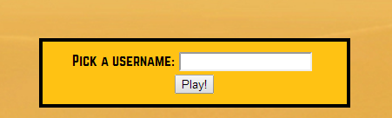
Realisations
Notes:
Matt

Slide 15
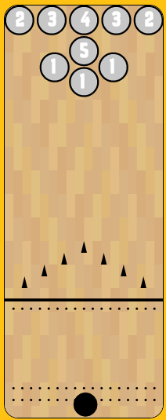
Realisations
// Gives us a "class" of a circle where we can use all the properties
function Circle(middlepointX, middlepointY, radius, nr) {
this.middlepointX = middlepointX;
this.middlepointY = middlepointY;
this.radius = radius;
this.nr = nr;
}
// the snap object with width and height
snapobj = Snap('#ballTrowLocation');
ballFieldWidth = $('#ballTrowLocation').width();
ballFieldHeight = $('#ballTrowLocation').height();
// we make all the holes
holesArray = new Array();
holesArray[0] = new Circle(ballFieldWidth / 2, 130, ballRadius + 4, '1');
//we show the holes at the top
var i;
for (i = 0; i < holesArray.length; i++) {
var hole = snapobj.circle(holesArray[i].middlepointX, holesArray[i].middlepointY, holesArray[i].radius);
}
Notes:
Ewout

Slide 16
Realisations
function showBackground() {
// Makes the wooden background
var counter = 0;
var i;
for (i = 0; i < ballFieldWidth; i += 15) {
// If i is even, create an indent of -120
// and make then pieces of wood
var j;
for ((i % 30 == 0 ? j = 0 : j = -120) ;
j < ballFieldHeight; j += 80) {
var woodblock = snapobj.rect(i, j, 16, 80);
var colour;
switch (counter % 7) {
case 0:
colour = '#D7AD7B'
break;
// all the different colors
}
woodblock.attr({
fill: colour
});
counter++;
}
// code for the dots
}
// code for the triangles
}
Notes:
Ewout

Slide 17
Realisations
function hoverInCanvas() {
// Eventlistener for when there is a click on the canvas
canvas.mousedown(onMouseDown);
}
// Method for when the mouse is down
function onMouseDown(mouseEvent) {
// If the mouse is on the ball, then you can move the ball
if (getDistance(mouseEvent.offsetX, mouseEvent.offsetY, ball.node.cx.baseVal.value, ball.node.cy.baseVal.value) <= ballRadius
&& mouseEvent.offsetY > 450) {
isMouseDown = true;
oldX = ball.node.cx.baseVal.value;
oldY = ball.node.cy.baseVal.value;
oldTime = 0;
time = Date.now();
// add additional event listeners for dragging
canvas.mouseup(onMouseUp);
canvas.mousemove(onMouseMove);
}
}
// When the mouse hovers out of the canvas, removes al the eventlisteners
// The ball will be thrown
function hoverOutCanvas() {
onMouseUp();
canvas.unmousedown(onMouseDown);
}
Notes:
Ewout

Slide 18
Realisations
// Check if the ball is above a hole
var i;
for (i = 0; i < holesArray.length; i++) {
if (holesArray[i].radius > getDistance(ball.node.cx.baseVal.value, ball.node.cy.baseVal.value, holesArray[i].middlepointX, holesArray[i].middlepointY)) {
isAboveHole = true;
console.log('The ball is above hole ' + holesArray[i].nr);
ballGoesInHole(holesArray[i]);
return;
}
}
// The ball goes to the middle of the hole
function ballGoesInHole(hole) {
console.log("Ball went into hole: " + hole.nr);
//Get the current state of the game
var tempGame = Games.findOne({}, { GameId: Session.get("GameId") });
//Increase the current location
tempGame.Players[Session.get("PlayerId")].CurrentLocation += parseInt(hole.nr) * 50;
//Update the game in the DB
Games.update(tempGame._id, tempGame);
//Reset the ball location
ball.animate({ cx: hole.middlepointX, cy: hole.middlepointY, r: 0 }, 1000);
setTimeout(resetBall, 1000);
}
Notes:
Ewout

Slide 19
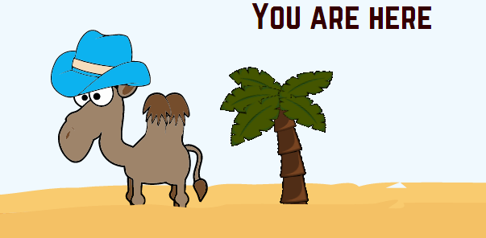
Realisations
Notes:
Robin
Placing svg and animating them.

Slide 20
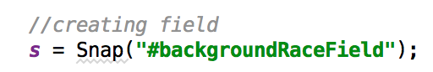




Realisations
Creating field
Add text to field
Add image to field
Animate image

Slide 21
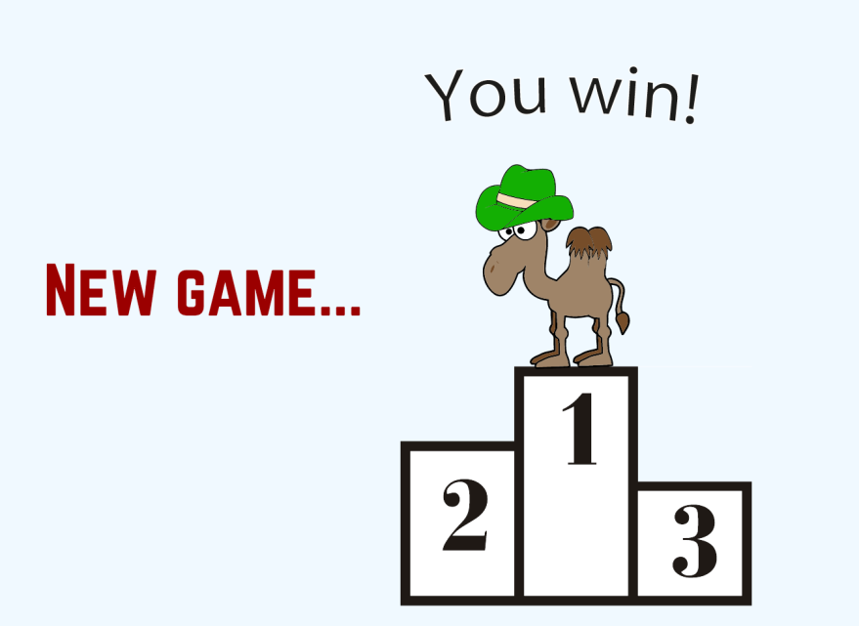
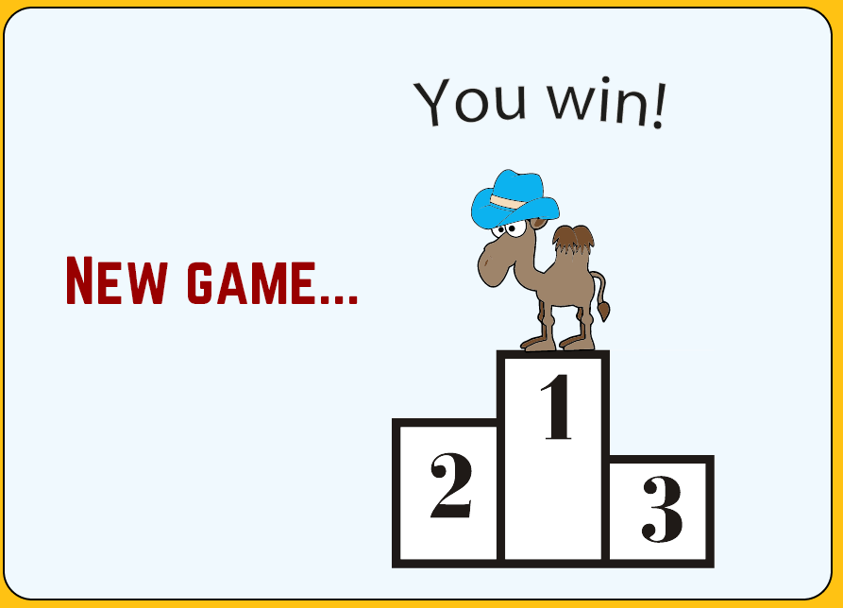
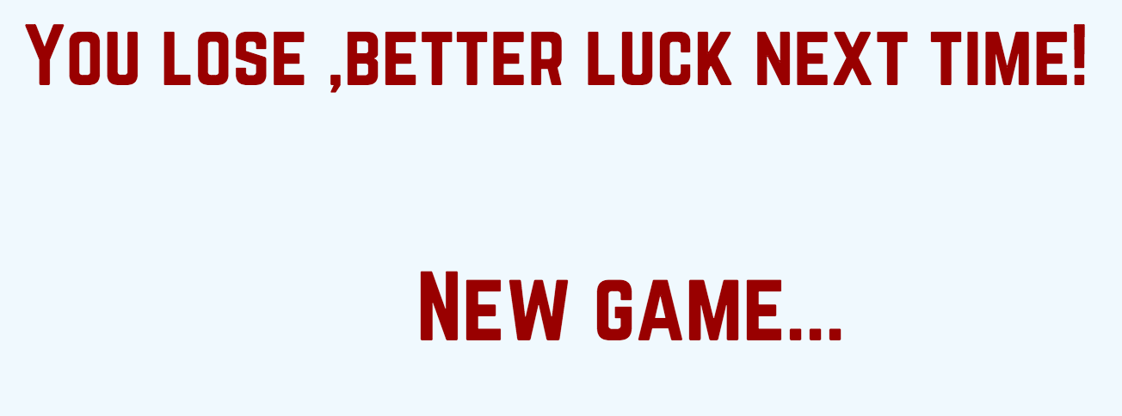
Realisations
Notes:
Robin

Slide 22




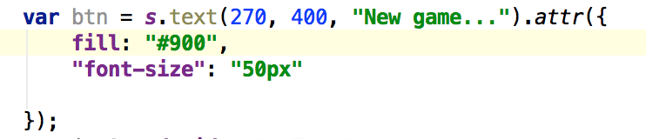
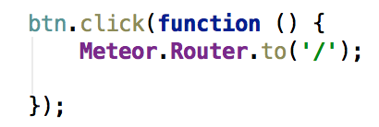
Realisations
Check finished
Check win/lose
Add win/lose message
New game

Slide 23
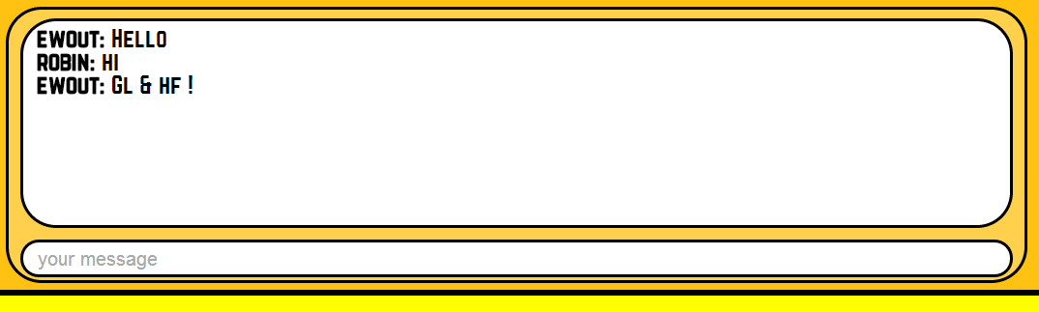
Realisations
Notes:
Matt

Slide 24
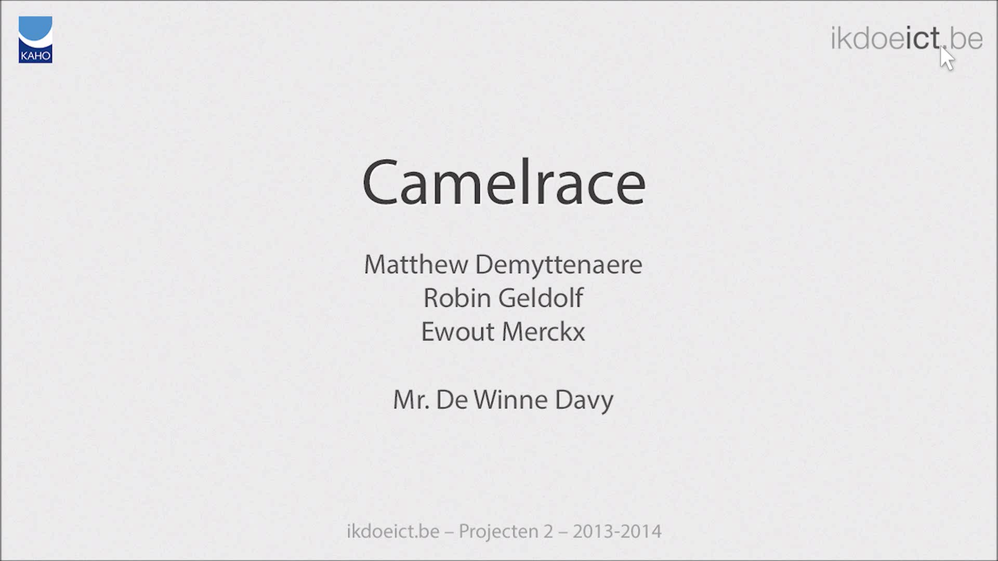
Demo
Notes:
Ewout

Slide 25

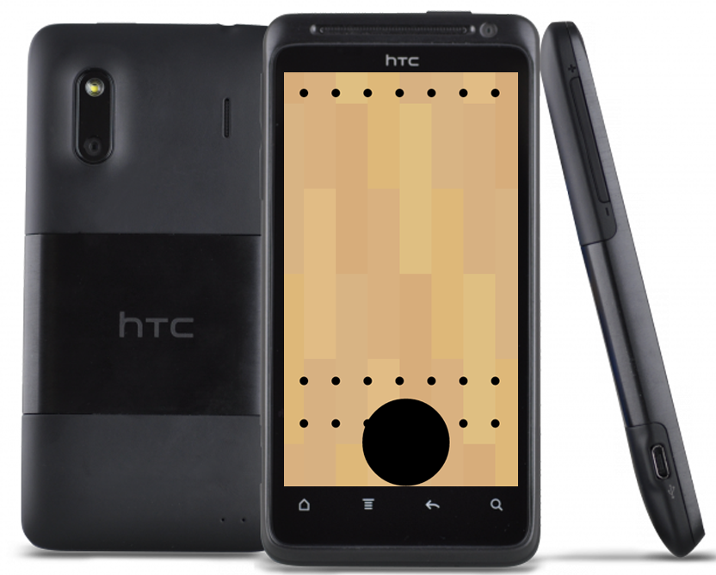
Not realized
Notes:
Ewout

Slide 26
Future and reflection
Integration on smart phone
Responsive design
Play vs. Computer/AI
Notes:
Matt

Slide 27
Conclusion
A multiplayer game
Working with meteor and node.js
SVG images
HTML5 + CSS3 + JS
MongoDB
Notes:
Matt

